Slide 1

Air Quality Monitor and Prediction

Slide 2
Agenda
Air quality problems
Air Quality Project with Trondheim Kommune
Assignment formulation
Practical guideline on data

Slide 3
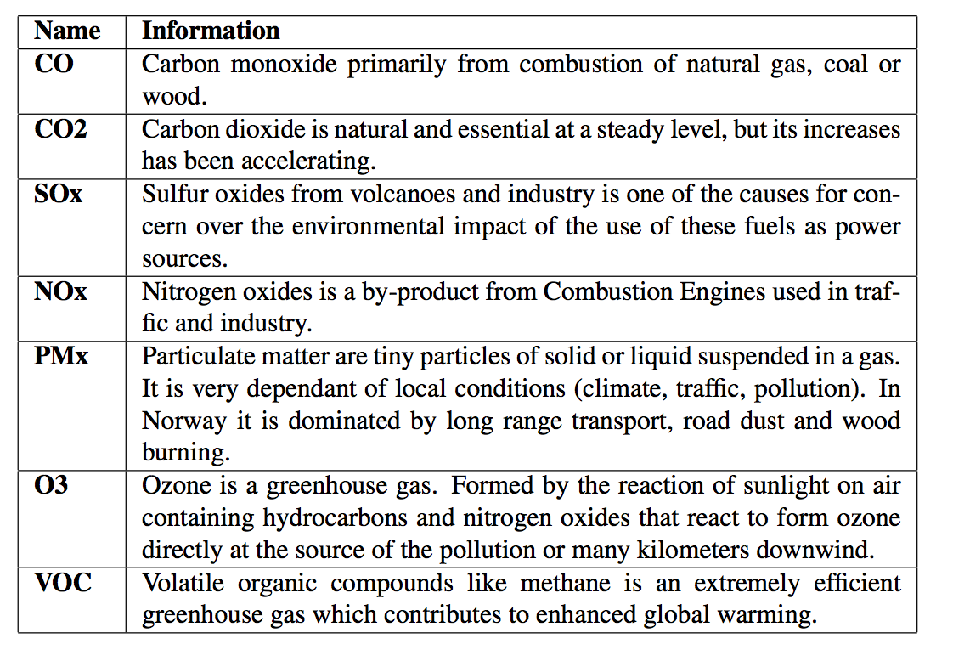

Main types of pollutants

Slide 4
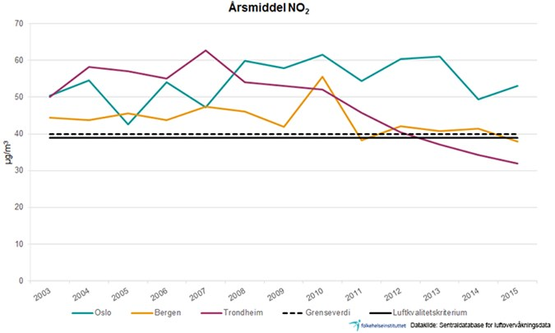
Norway is clean country, but still having air quality pollution
Illustration: Norwegian Institute of Public Health
Notes:
https://www.fhi.no/en/op/hin/environment/air-pollution-in-norway---public-he/

Slide 5
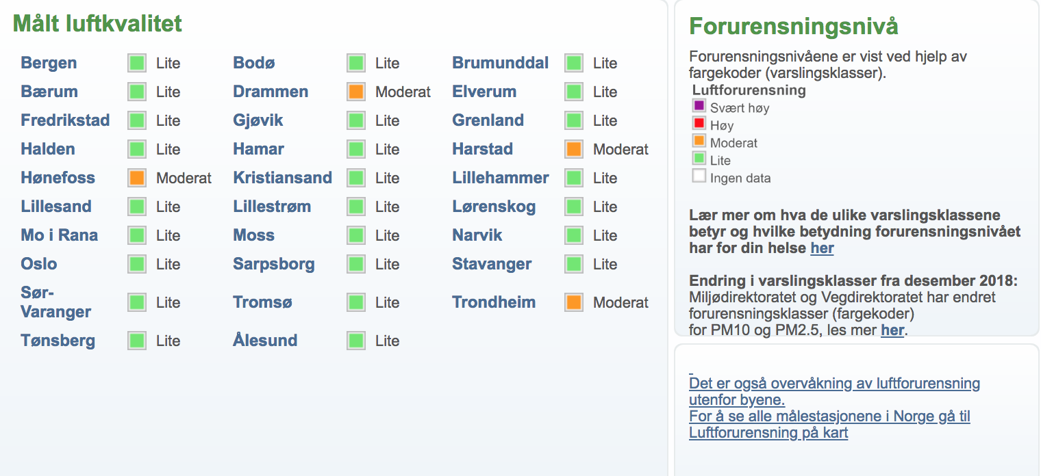
As of today measured air quality in Norway
http://luftkvalitet.info

Slide 6
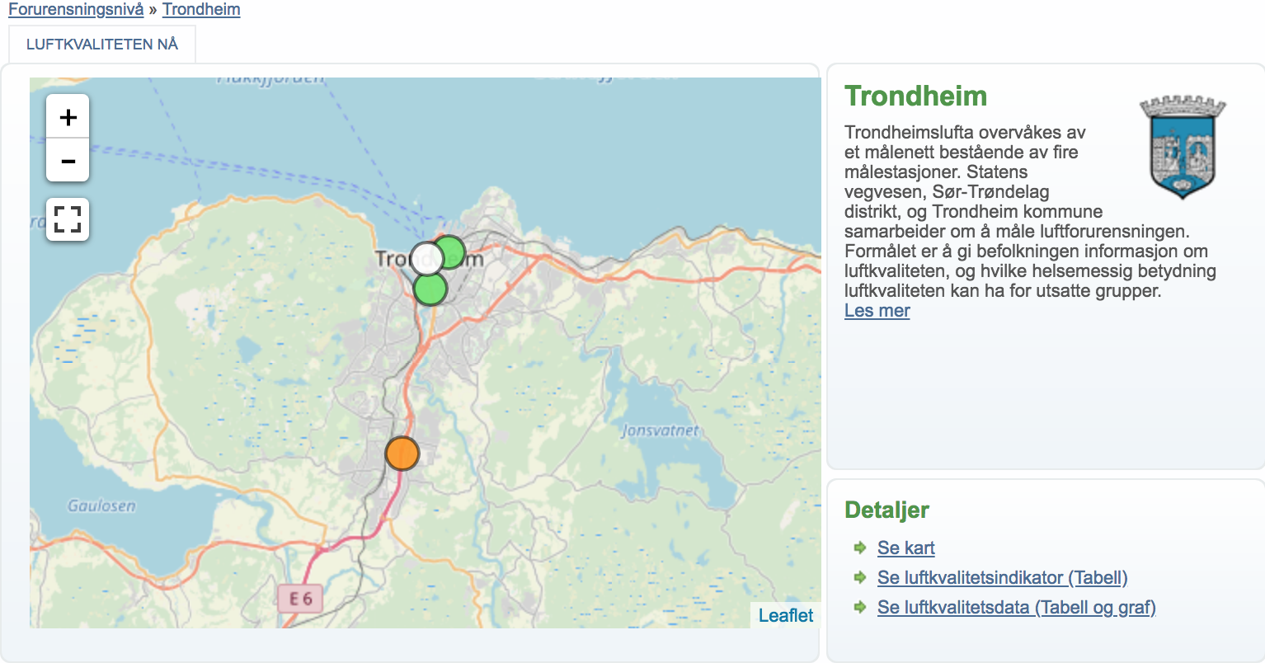
Measured air quality in Trondheim

Slide 7
Gaps
Sensors are expensive
Only 4 fixed locations in Trondheim, not enough coverage
Not yet mobile app for citizen
Not yet good prediction of air quality

Slide 8
Air quality project with Trondheim Kommune

Slide 9
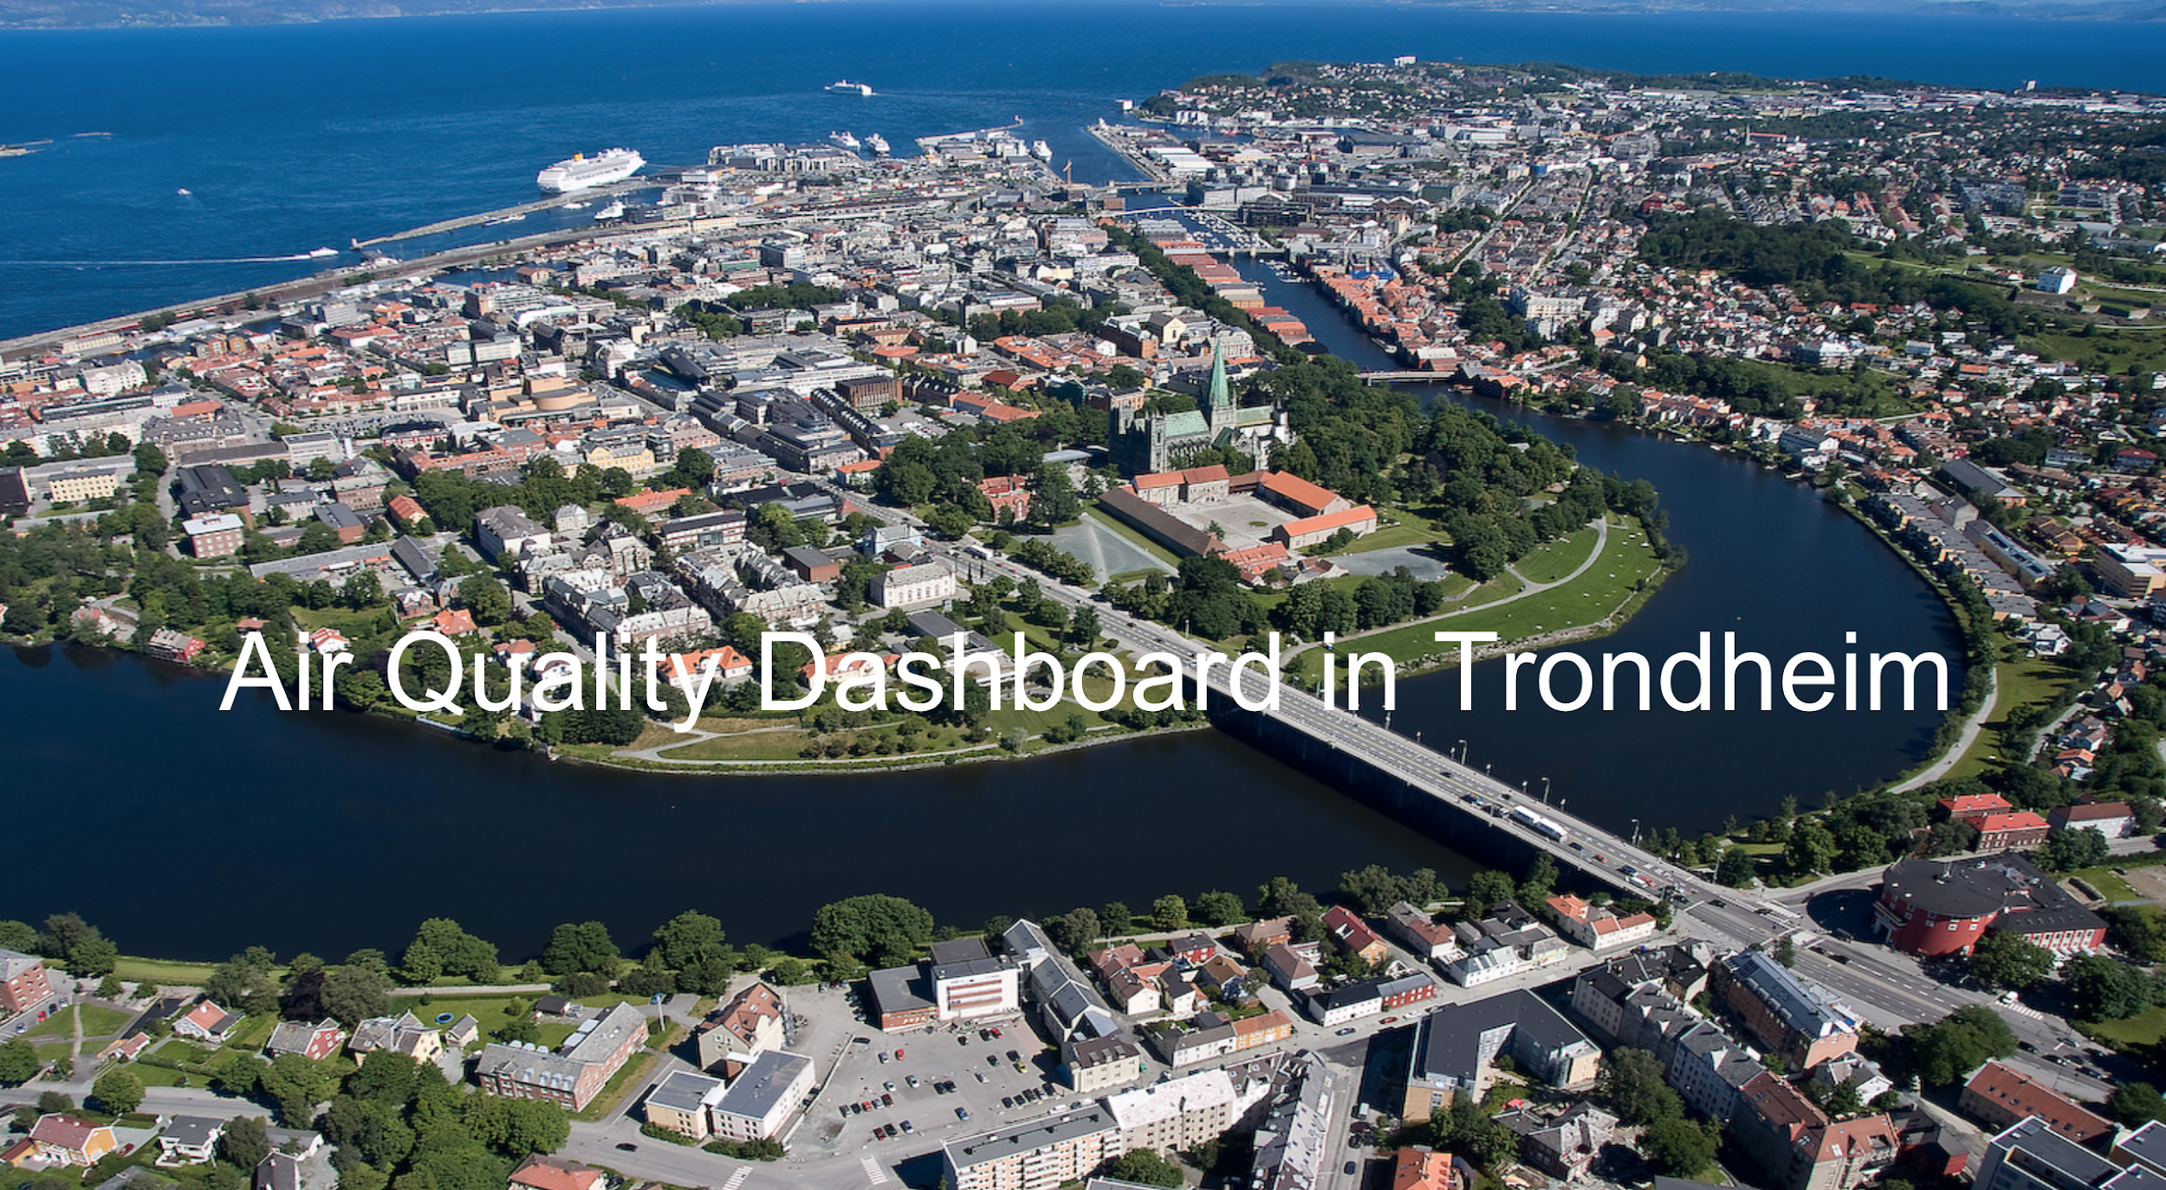

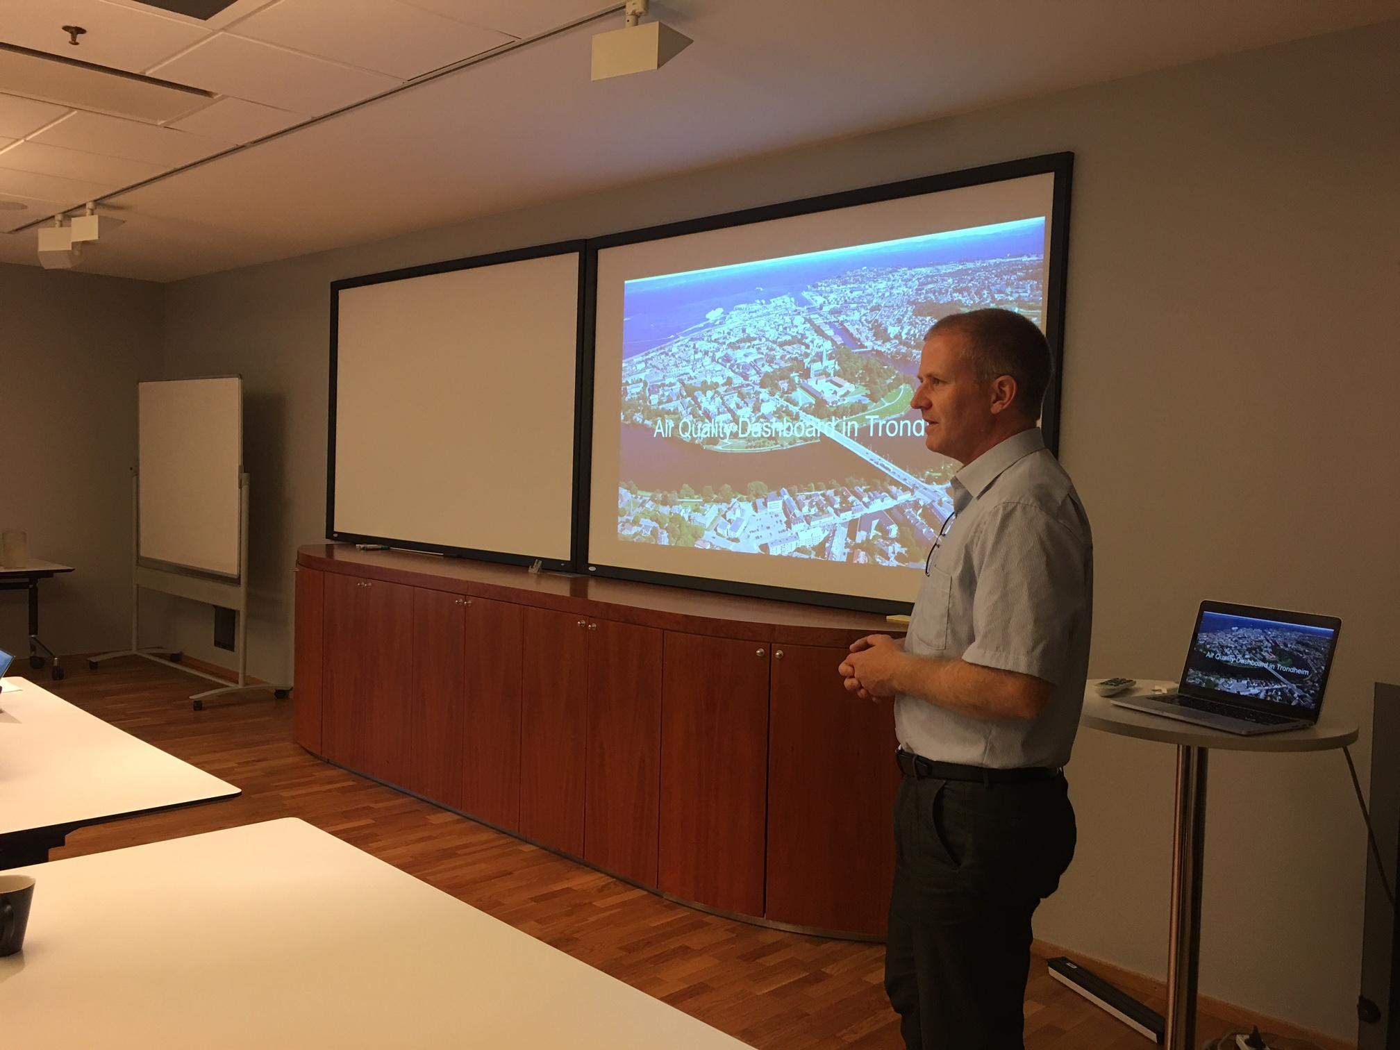
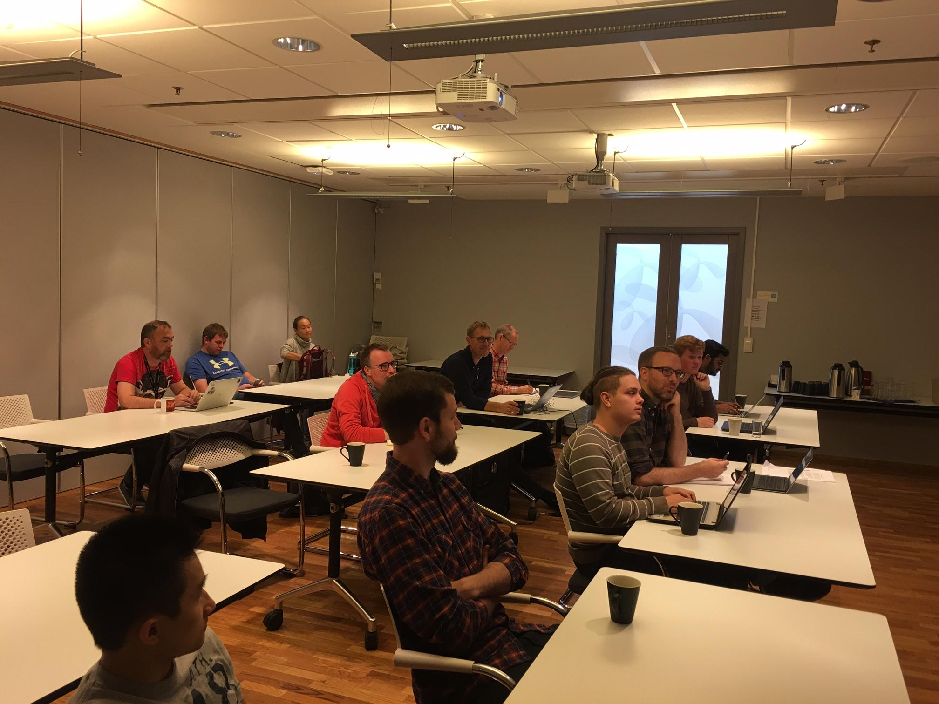
Air Quality Monitor in Trondheim using NB-IoT

Slide 10
Objectives
Develop and test cheap sensors to provide good data
Build a mobile app and web app for air quality monitoring with more comprehensive coverage in Trondheim
Develop and test AI/ML methods for air quality prediction/forecast

Slide 11
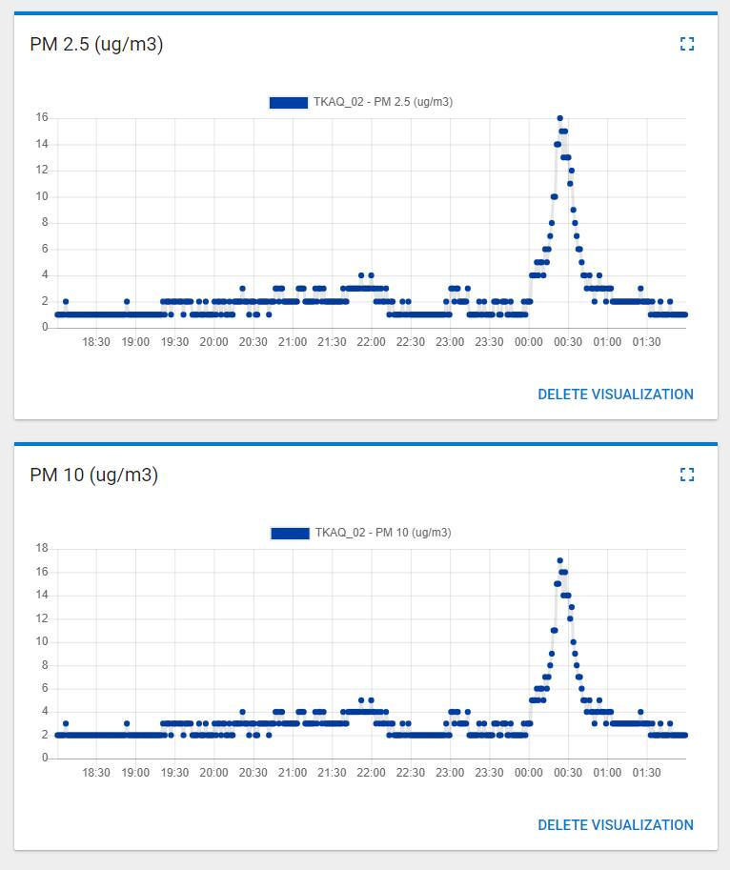
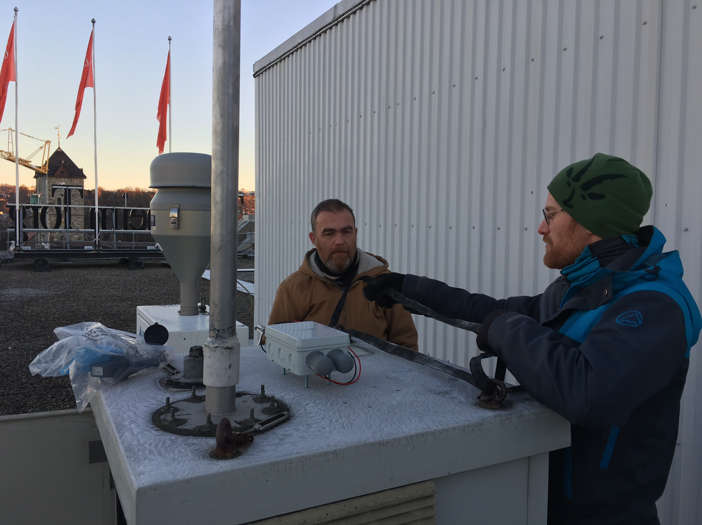
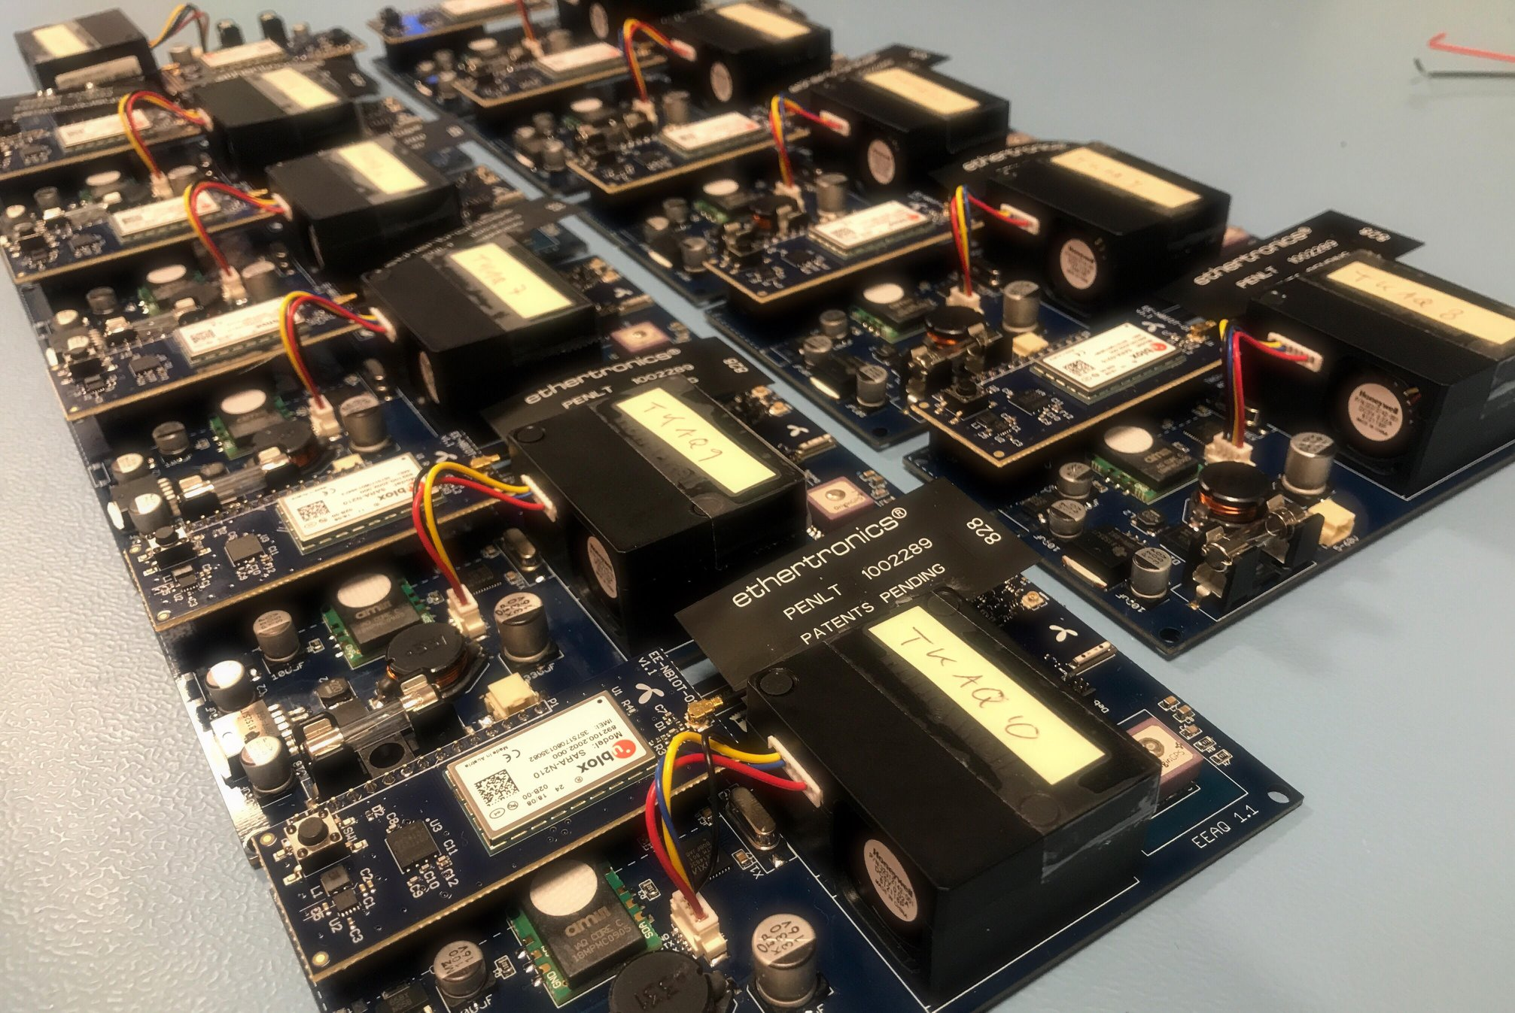
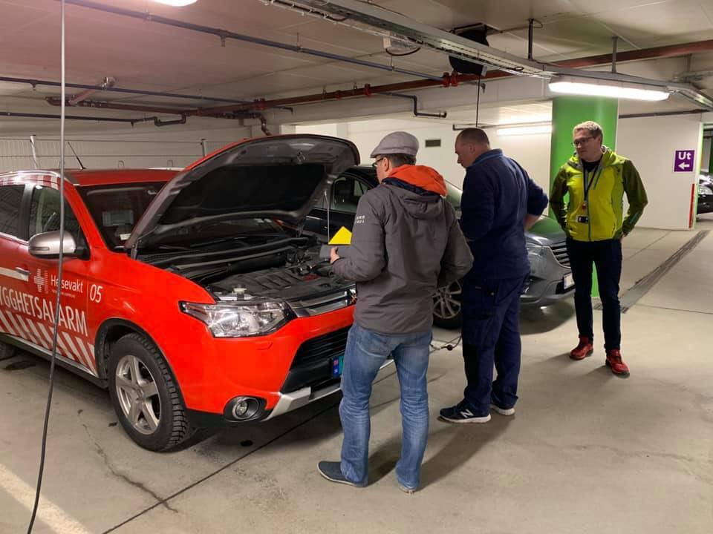
Objective 1: Together with EE and Trondheim Kommune, we are testing devices and checking data quality

Slide 12
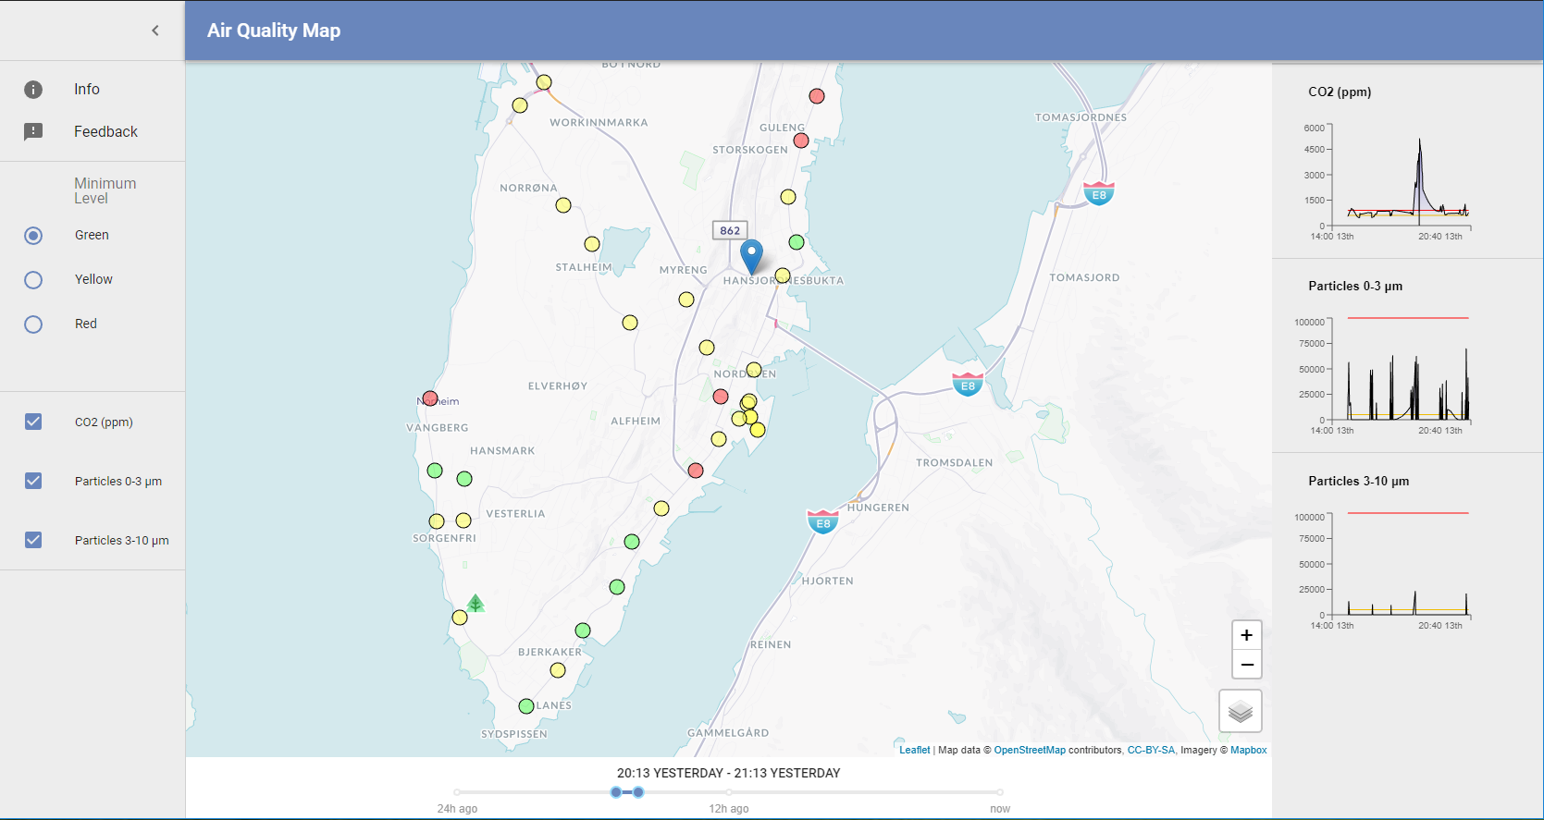
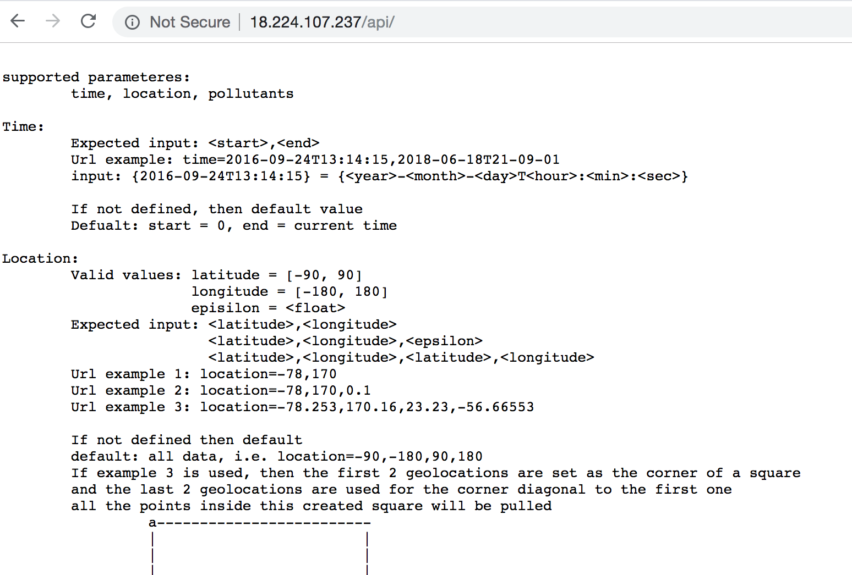
Objective 2: MVP of the 2D of Air quality dashboard and APIs have been built by NTNU students in 2018

Slide 13
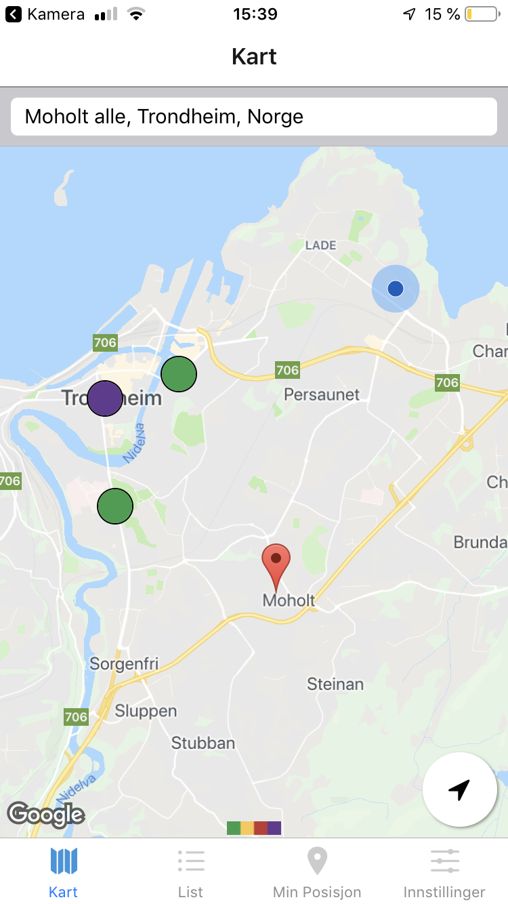
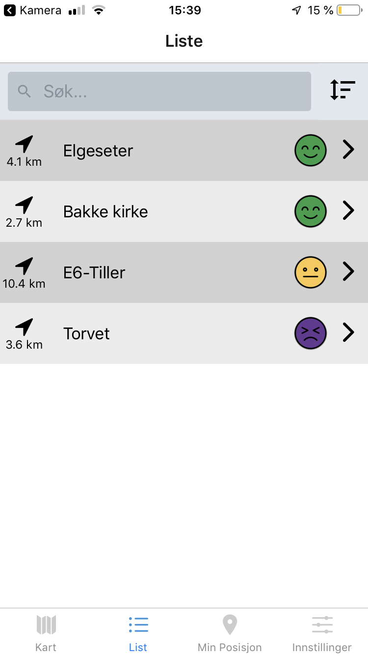
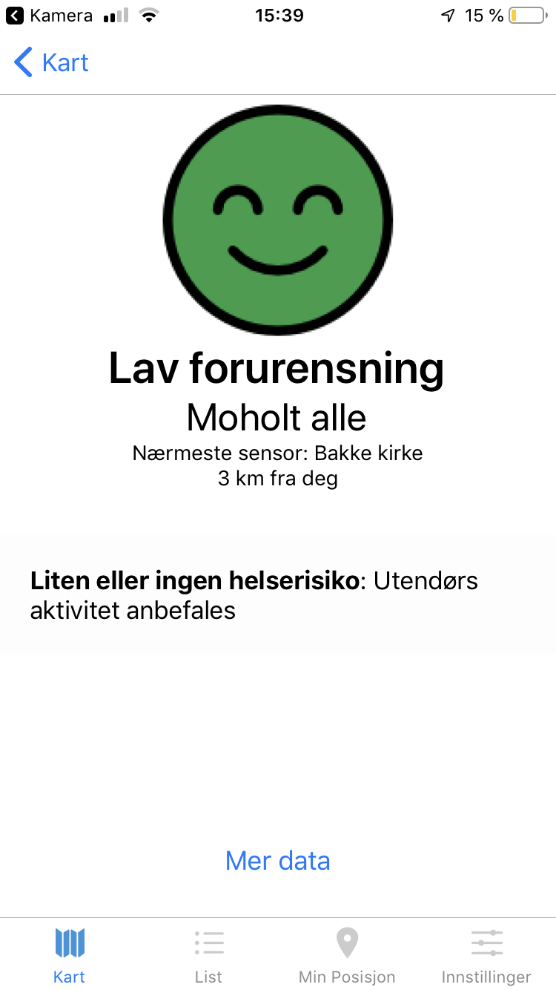
Objective 2: A group of NTNU students is making a mobile app for Air Quality Monitor for citizens in Trondheim

Slide 14
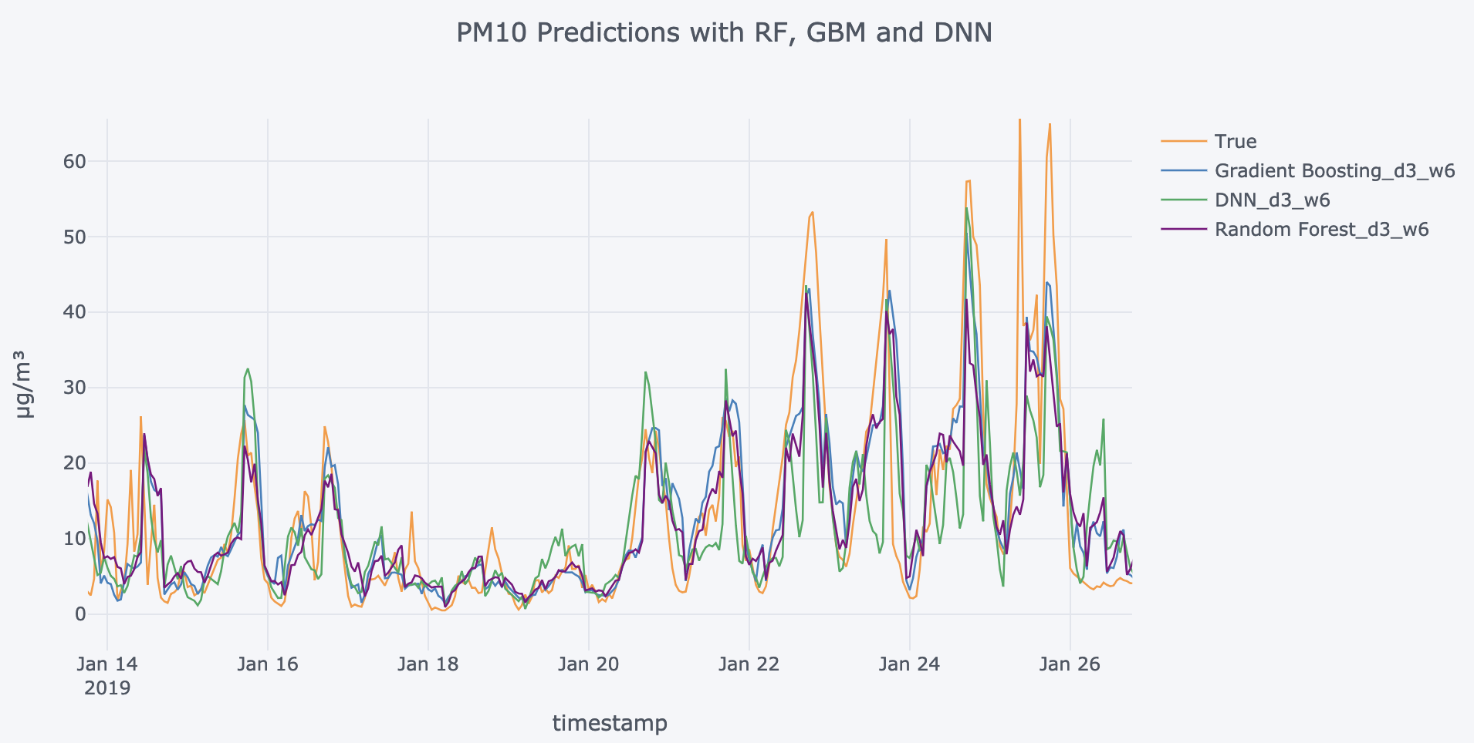
Objective 3: Air quality prediction

Slide 15
About the tasks

Slide 16
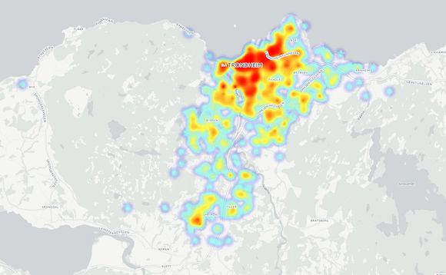
Task 1: Visualize the data from cars. There will be a lot of data collected from sensors mounted to moving cars

Slide 17

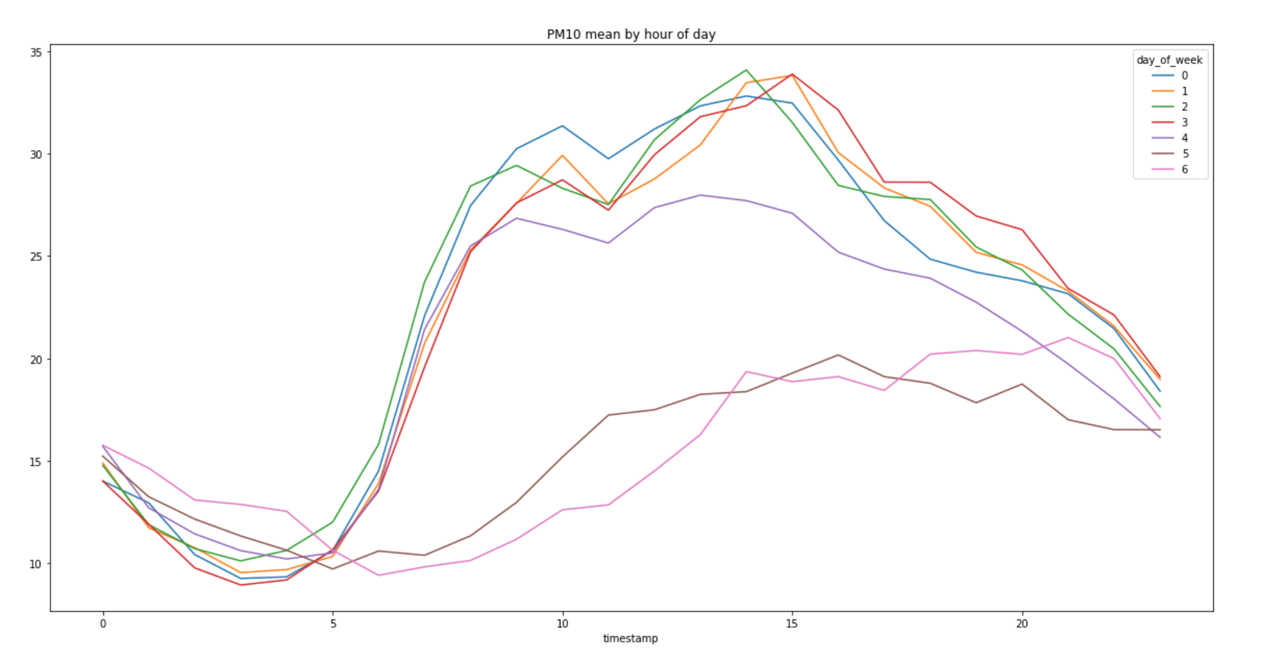



Task 2: Predicting the air quality by combining data from NILU, Yr.no, Telenor and possible Trondheim Kommune data
Air quality measured at fixed locations
Weather data
Air quality measured by sensors on cars
Traffic data

Slide 18
Practical information

Slide 19
On the data
Data collected from NILU’s sensors
Data collected from Telenor’s sensors
Data from Trondheim Kommune, such as traffic data
Date from Yr.no: weather data

Slide 20
On the GPUs
Two GPU nodes, so both anakin01 and anakin02, they are identical.
$ /work/hackathon
The folder names are the same, but it is not the same drives physically.
The IP of anakin01 is: 129.241.113.25
The IP of anakin02 is: 129.241.113.29, $ /work/hackathon
We will create local users for the hackathon, one for each group and have the same number of groups on each of the nodes, so e.g. 5 teams on each node.
GPU: 2x NVIDIA Tesla V100 32GB
CPU: 2x Intel Xeon Gold 6132 2.6G, 14C/28T, 10.4GT/s 2UPI, 19M Cache, Turbo, HT (140W) DDR4-2666
RAM: 24x 32GB = 768GB

Slide 21
About the Telenor’s sensors
We will provide 5 sensors for each team to play with.
But please don’t make a smoke for measuring the sensors inside the buildings.

Slide 22
Useful reference

Slide 23


